Slide 1
Welcome to our web forum
June 2016

Slide 2
AGENDA
what we’re working on
staff profiles/groupings
research centres
web best practice
what’s next?

Slide 3
Student application journey

Slide 4
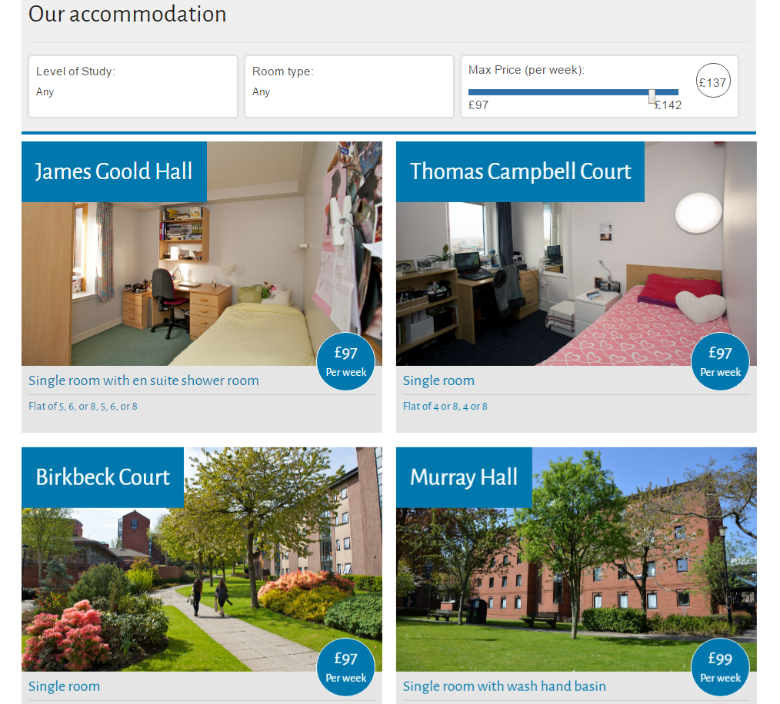
New sections
Accommodation pages

Slide 5
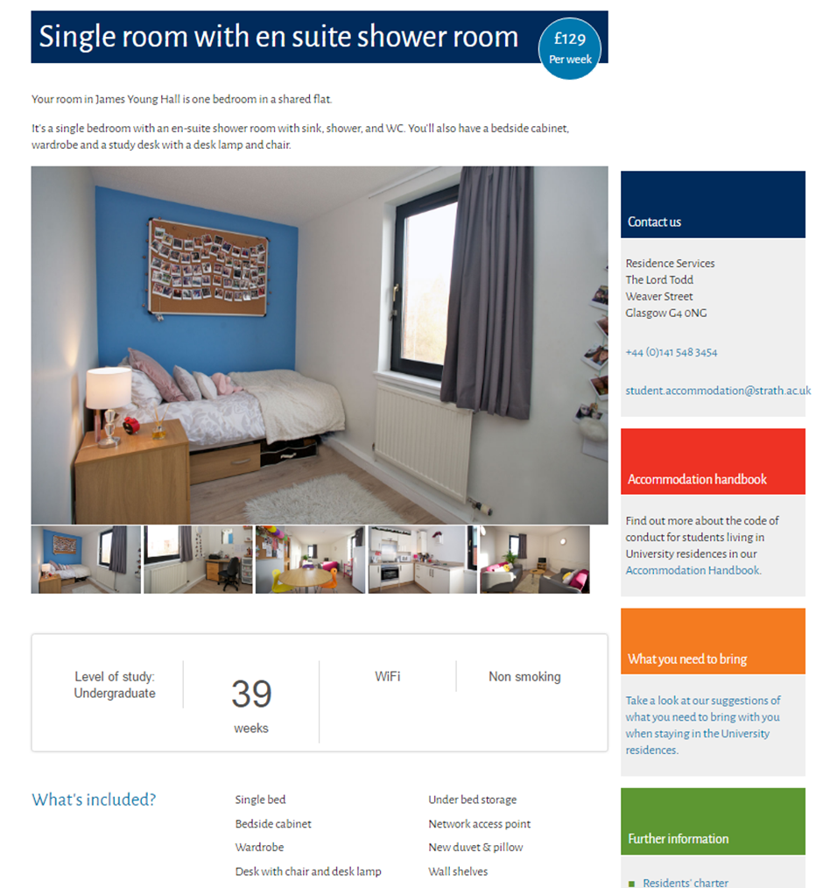

Slide 6
Alumni pages

Slide 7
Research centres

Slide 8
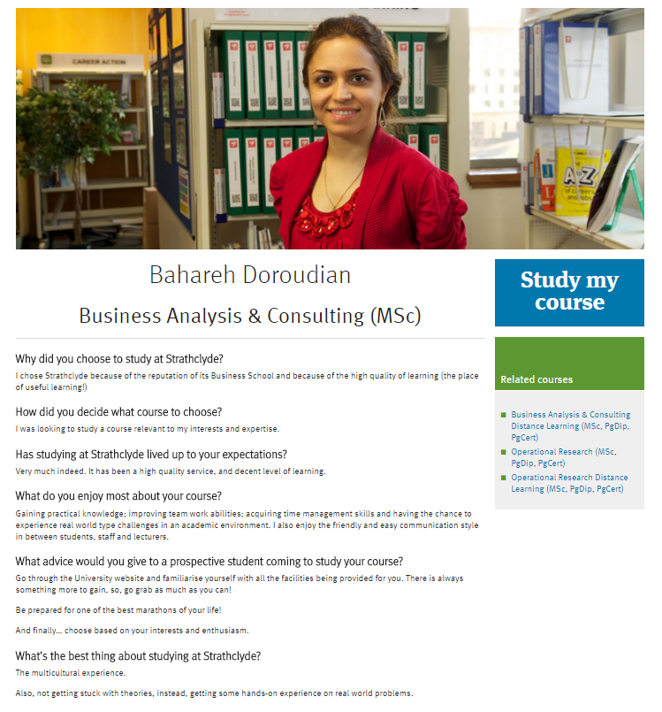
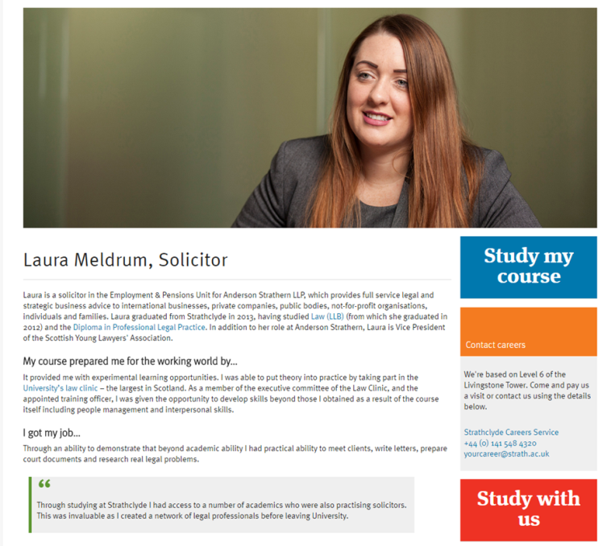
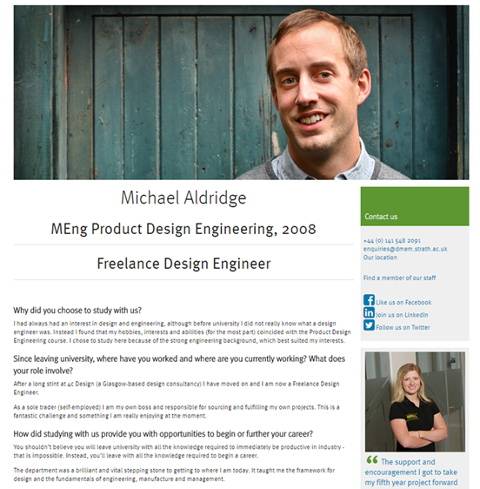
Profiles

Slide 9
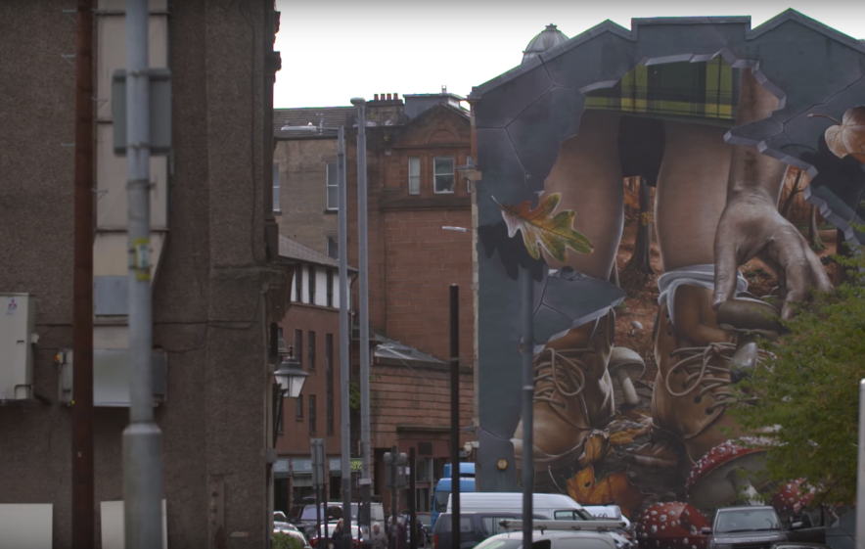
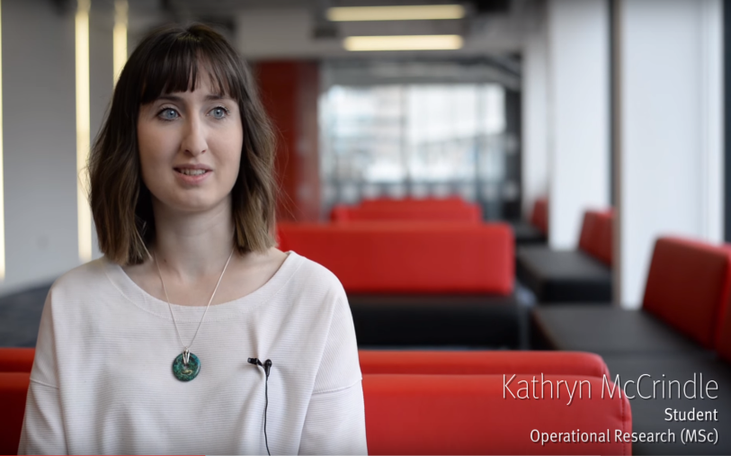
Videos

Slide 10
Staff profiles/groupings
Improved staff profiles
Currently pulling six most recent favorited publications
Work will commence next month on Project and Activities
Review other required content

Slide 11
Staff profiles/groupings
Profiles for PGR students on the staff list
Requirement for explicit consent to include PGR students profile pages on the web.
Development of online registration form will include question asking for permission.
Maintained in Pegasus.

Slide 12
Staff profiles/groupings
Profiles for non Standard staff
For staff “Staff” out with the normal HR system.
Development scoped out to provide the functionality, commencing next month.
Maintained in T4 by departments.
Not included in staff grouping.

Slide 13
Staff profiles/groupings

Slide 14
Staff profiles/groupings
New method of grouping staff
This will enable groups of staff to be managed from within Pegasus.
Will be able to use this to publish staff lists on web site.
List can be cross department and faculty.
List can include PGR students

Slide 15
Research centre template
http://beta-www.strath.ac.uk/comingsoon/centre/genericresearchcentre/

Slide 16
Web best practice
A few do’s and don’ts
Keep written content conversational in tone
Don’t paste content straight in from Word
No abbreviations without explanation
Use paragraphs
Use headings in order of importance
Don’t start a link with directional text. For example: ‘click here for more information’
Don’t use italics
Refer to our content guide for more info - http://beta-www.strath.ac.uk/yourdepartmentaltoolkit/documentation/guidelines/content/

Slide 17
Web best practice
A few do’s and don’ts
Break your page up using different templates, quote template and breakout-box style
News & events items should be a heading and a sentence linking to a larger article
Crop & resize images to correct sizes before adding them.
Include image dimensions in name and keyword fields. Also include a description.
Choose image in T4 – not Image and Thumbnail
Refer to our content guide for more info - http://beta-www.strath.ac.uk/yourdepartmentaltoolkit/documentation/guidelines/content/

Slide 18
What’s next?
Complete student journey information
Strathclyde recruitment pages
Research and Work with us pages
Personalisation
Student recruitment/digital marketing campaigns

Slide 19
Questions?
Get in touch:
webcontent@strath.ac.uk

